Slide 1
C Control Statements
Control statements control the order of execution in a C program, based on data values and conditional logic. Control flow statements, however, break up the flow of execution by employing decision making, looping, and branching, enabling your program to conditionally execute particular blocks of code.
Control statement describes the decision-making statements (if-then, if-then-else, switch), the looping statements (for, while, do-while), and the branching statements (break, continue, return) supported by the C programming language.

Slide 2
There are four main categories of control flow statements;
  1. Sequence structure
    Statements run one after the other
  2. Selection structure
    Depending on a condition, do one thing; otherwise, do something else
    Examples in C: if, if else, and switch.
  3. Repetition structure
    Repeat some actions over and over
    Examples in C: for loops, while loops, and do/while loops.
  4. Transfer statements: break, continue, return.

Slide 3
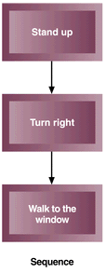
1. Sequence structure
    Statements run one after the other.

Slide 4
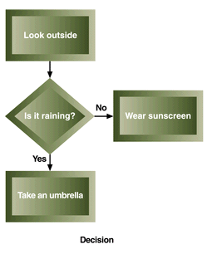
2. Selection structure
    Depending on a condition, do one thing; otherwise, do something else.

Slide 5
If Statement
The if statement executes a block of code only if the specified expression is true.
If the value is false, then the if block is skipped and execution continues with the rest of the program.
Syntax:
if(<conditionalexpression>)
<statementaction>

Slide 6
if Flow Chart
temperature >=85
true
print “It is hot”
false

Slide 7
//Java program for IF Statement
public class IfStatementDemo
{
public static void main(String[ ] args)
{
int a = 10, b = 20;
if(a > b)
System.out.println("a > b");
if(a < b)
System.out.println("b > a");
}
}

Slide 8
If-else Statement
The if/else statement is an extension of the if statement.
If the statements in the if statement fails, the statements in the else block are executed.
Syntax:
if(<conditionalexpression>)
<statementaction>
else
<statementaction>

Slide 9
if/else Flow Chart
False
True
grade >=60
Print “You failed”
Print “You passed”

Slide 10
//Java program for concept of IF-ELSE Statement
public class IfElseStatementDemo
{
public static void main(String[ ] args)
{
int a = 10, b = 20;
if(a > b)
{
System.out.println("a > b");
}
else
{
System.out.println("b > a");
}
}
}

Slide 11
//Java program to add two numbers using swings.
import java.io.*;
import javax.swing.*;
class addition
{
public static void main(String args[ ])
{
int a,b,c;
JOptionPane.showMessageDialog(null,"Enter a,b values");
a=Integer.parseInt(JOptionPane.showInputDialog("a"));
b=Integer.parseInt(JOptionPane.showInputDialog("b"));
c=a+b;
JOptionPane.showMessageDialog(null,"Result="+c+'\n');
}
}

Slide 12
//java program for if-else statement
import javax.swing.JOptionPane;
public class PassFail
{
public static void main(String[] args)
{ int grade;
String gradeAsString;
gradeAsString = JOptionPane.showInputDialog (null,"What is your grade?");
grade = Integer.parseInt (gradeAsString);
if ( grade >= 60 )
{
JOptionPane.showMessageDialog(null,"You passed!!!" );
JOptionPane.showMessageDialog(null,"Congratulations!");
}
else
{
JOptionPane.showMessageDialog(null,"You failed!");
}
}
}

Slide 13
Switch Case Statement
The switch case statement, also called a case statement is a multi-way branch with several choices.
A switch is easier to implement than a series of if/else statements.
Each label must equate to an integer constant and each must be unique.
When the switch statement executes, it compares the value of the controlling expression to the values of each case label.

Slide 14
The switch statement allows for any number of possible execution paths.
Syntax
switch (<non-long integral expression>)
{
case label 1: <statement1>;
case label 2: <statement2>;
.... ….. ….. …..
case label n: <statementn>; default: <statement>;
}

Slide 15
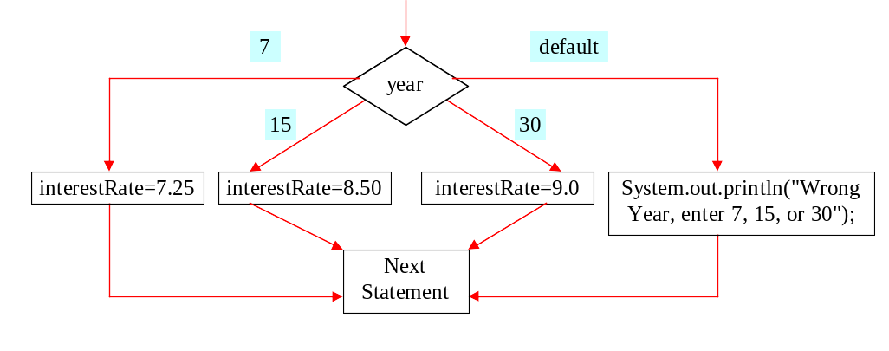
switch Statement Flow Chart

Slide 16
//JAVA PROGRAM FOR SWITCH STATEMENT
class SwitchDemo
{
public static void main(String[ ] args)
{
int month = 8;
switch (month)
{ case 1: System.out.println("January"); break;
case 2: System.out.println("February"); break;
case 3: System.out.println("March"); break;
case 4: System.out.println("April"); break;
case 5: System.out.println("May"); break;
case 6: System.out.println("June"); break;
case 7: System.out.println("July"); break;
case 8: System.out.println("August"); break;
case 9: System.out.println("September"); break;
case 10: System.out.println("October"); break;
case 11: System.out.println("November"); break;
case 12: System.out.println("December"); break;
default: System.out.println("Invalid month.");break;
}
}
}

Slide 17
//Java program for concept of switch case
public class SwitchCaseStatementDemo
{ public static void main(String[ ] args)
{ int a = 10, b = 20, c = 30;
int status = -1;
if(a > b && a > c)
{ status = 1;
}
else if(b > c)
{ status = 2;
}
else
{ status = 3;
}
switch(status)
{ case 1: System.out.println ("a is the greatest"); break;
case 2: System.out.println ("b is the greatest"); break;
case 3: System.out.println ("c is the greatest"); break;
default: System.out.println ("Cannot be determined");
}
}
}

Slide 18
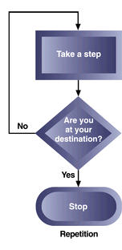
3. Repetition structure
    Repeat some actions over and over

Slide 19
While Statement
The while statement is a looping construct control statement that executes a block of code while a condition is true.
The loop will never be executed if the testing expression evaluates to false.
The loop condition must be a boolean expression.
A while statement (pre test) checks at the beginning of a loop to see whether the next loop iteration should occur.
While is a entry control loop statement.
Syntax:
while (<loop condition>)
{
<statements>;
}

Slide 20
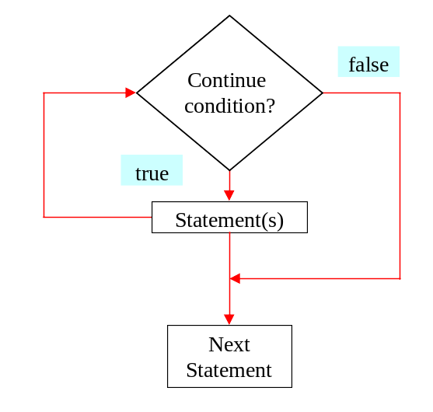
while Loop Flow Chart

Slide 21
//Java program for while loop concept
public class WhileLoopDemo
{
public static void main(String[ ] args)
{
int count = 1;
System.out.println ("Printing Numbers from 1 to 10");
while( count <= 10)
{
System.out.println(count++);
}
}
}

Slide 22
do-while Loop Statement
The do-while loop is similar to the while loop, except that the test is performed at the end of the loop instead of at the beginning.
A do-while loop begins with the keyword do, followed by the statements that make up the body of the loop. When the loop condition becomes false, the loop is terminated and execution continues with the statement immediately following the loop.
do-while is a Exit control loop statement.
Syntax
do
{
<loop body>
}while (<loop condition>);

Slide 23
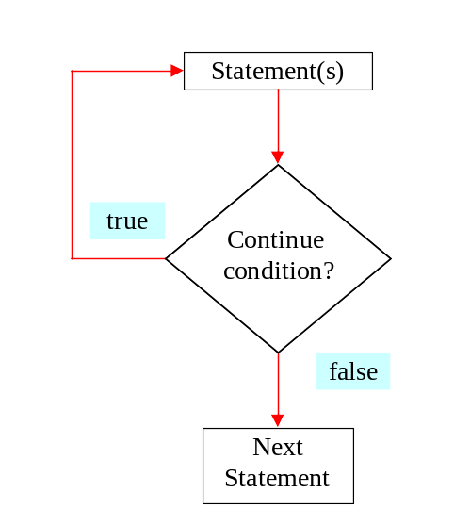
Do-while Loop Flow Chart

Slide 24
//Java program for concept of do-while statement
public class DoWhileLoopDemo
{
public static void main(String[] args)
{
int count = 1;
System.out.println ("Printing Numbers from 1 to 10");
do
{
System.out.println(count++);
}while( count <= 10);
}
}

Slide 25
For Loop
The for loop is a looping construct which can execute a set of instructions a specified number of times. It’s a counter controlled loop.
Syntax
for (<initialization>; <loop condition>; <increment expression>)
{
<loop body>
}

Slide 26
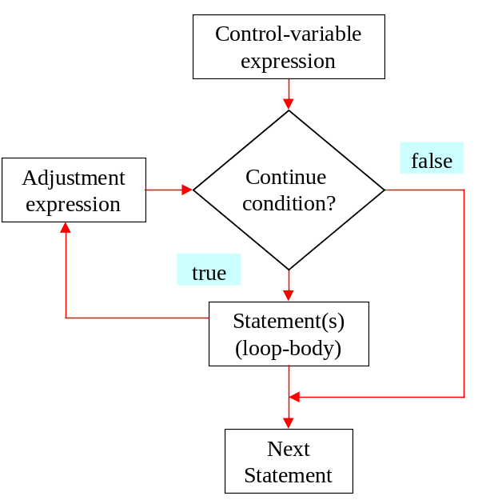
for Loop Flow Chart

Slide 27
//Java program for concept of for loop
public class ForLoopDemo
{
public static void main(String[ ] args)
{
System.out.println ("Printing Numbers from 1 to 10");
for(int count =1; count <=10; count++)
{
System.out.println(count);
}
}
}

Slide 28
//Random Number Generations program
class RandomDemo
{
public static void main(String args[ ])
{
for(int i=1;i<=10;i++)
{
System.out.println((int)(Math.random()*100));
}
}
}

Slide 29
Recursion vs. Iteration
1.It means the function calls itself. | 1.It means that repeat some actions over and over.
2. High memory consumption. | 2. Less memory consumption.
3. It uses a selection structure like if, if-else etc. | 3. It uses a repetitive structure like while, do-while and for etc.
4. It terminates when base case is recognized. | 4. It terminates when the loop continuation condition fails.
5. It can occur infinitely. | 5. It can occur infinitely.
6. Extra memory is required. | 6. Extra memory is not required.

Slide 30
Transfer Statements
1.Continue Statement: A continue statement stops the iteration of a loop (while, do or for) and causes execution to resume at the top of the nearest enclosing loop.
You use a continue statement when you do not want to execute the remaining statements in the loop, but you do not want to exit the loop itself.
Syntax:
continue; //the unlabeled form
continue <label>; // the labeled form

Slide 31
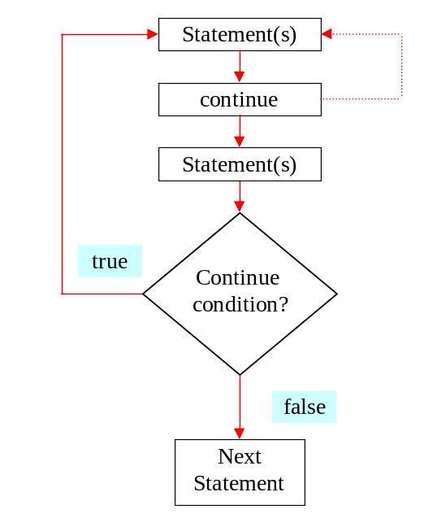
The continue Keyword

Slide 32
//Java program for continue concept
public class ContinueExample
{
public static void main(String[ ] args)
{
System.out.println ("Odd Numbers");
for (int i = 1; i <= 10; ++i)
{ // Rest of loop body skipped when i is even
if (i % 2 == 0) continue;
System.out.println(i + "\t");
}
}
}

Slide 33
2.Break Statement
The break statement transfers control out of the enclosing loop ( for, while, do or switch statement).
We use a break statement when you want to jump immediately to the statement following the enclosing control structure.
The label name is optional, and is usually only used when you wish to terminate the outermost loop in a series of nested loops.
Syntax:
break; // the unlabeled form
break <label>; // the labeled form

Slide 34
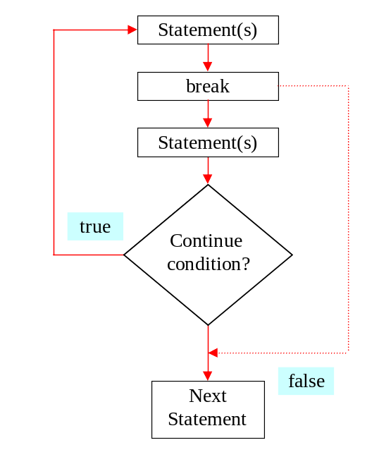
The break Keyword

Slide 35
//java program for labeled break statement
class LabelDemo
{ public static void main(String [ ]args)
{
AAA:
{
System.out.println("Block AAA");
BBB:
{
System.out.println("Block BBB");
CCC:
{
if(true)
break BBB;
}
System.out.println("Out of Block CCC");
}
System.out.println("Out of Block BBB");
}
System.out.println("Out of Block AAA");
}
}

Slide 36
//Java program concept of Break
public class BreakExample
{
public static void main(String[ ] args)
{
System.out.println ("Numbers 1 - 10");
for (int i = 1; ; ++i)
{
if (i == 11)
break;
// Rest of loop body skipped when i is even
System.out.println(i + "\t");
}
}
}

Slide 37
3.return Statement
The return statement exits from the current method, and control flow returns to where the method was invoked.
The return statement has two forms: one that returns a value, and one that doesn't.
To return a value, simply put the value after the return keyword.
The data type of the returned value must match the type of the method's declared return value.

Slide 38
//factorial program using recursion and return statement
public class Factorial
{
public static long factorial( int n )
{
if( n <= 1 )
return 1;
else
return n * factorial( n - 1 );
}
public static void main( String [ ] args )
{
for( int i = 1; i <= 10; i++ )
System.out.println( factorial( i ) );
}
}

Slide 39
//java program to find Factorial of n using recursion with return statement
class Factorial
{
public static int fact(int n)
{
if(n==0 || n==1)
return 1;
else
return n*fact(n-1);
}
public static void main(String args[ ])
{
int n=5;
System.out.println("FACTORIAL of "+ n +" is:" + fact(n));
}
}

Slide 40
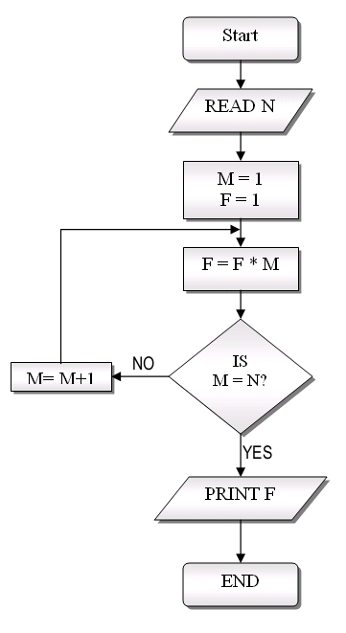
FLOWCHART FOR FAOR CTORIAL FOR N NUMBER

Slide 41
TEST
The most basic control flow statement supported by the C programming language is the ___ statement.
The ___ statement allows for any number of possible execution paths.
The ___ statement is similar to the while statement, but evaluates its expression at the ___ of the loop.
How do you write an infinite loop using the for statement?
How do you write an infinite loop using the while statement?

Slide 42
The most basic control flow statement supported by the Java programming language is the if-then statement.
The switch statement allows for any number of possible execution paths.
The do-while statement is similar to the while statement, but evaluates its expression at the bottom of the loop.
Question: How do you write an infinite loop using the for statement?
Answer: for ( ; ; ) { }
5. Question: How do you write an infinite loop using the while statement?
Answer: while (true) { }

